Slide 1
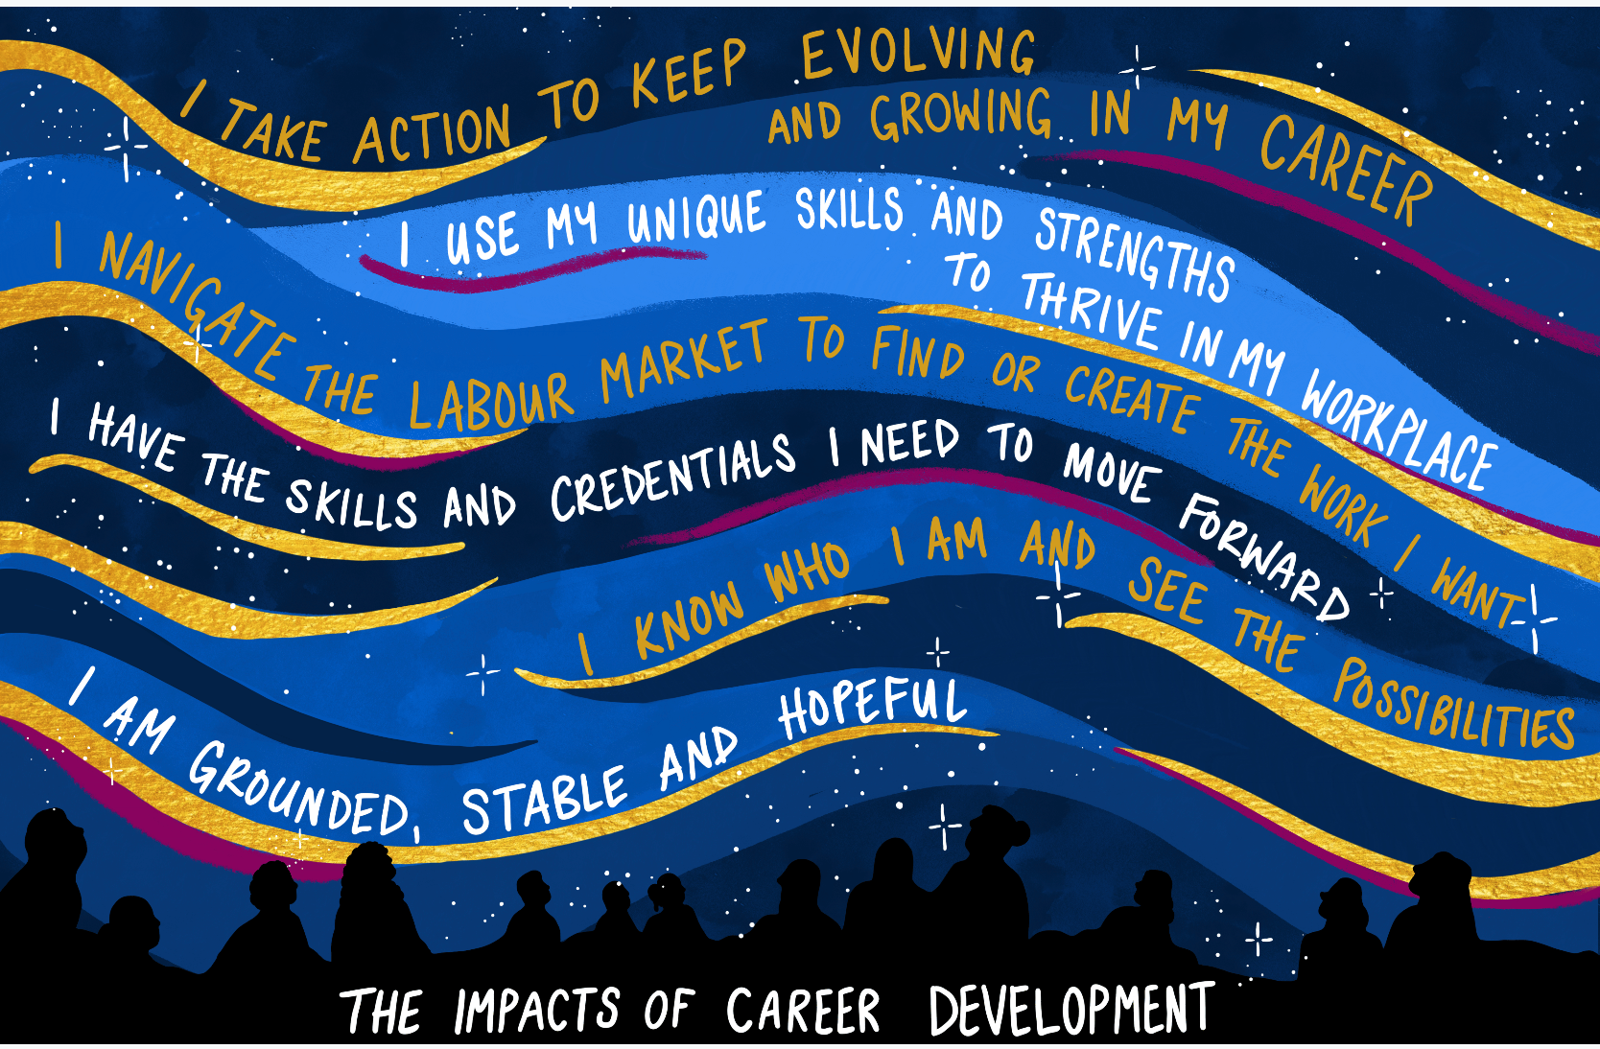
Embracing our Role as Practitioner-Researchers
Sareena Hopkins
Executive Director
Canadian Career Development Foundation (CCDF)
February 16, 2023

Slide 2
This is where I am right now!

Slide 3
Big questions…
What difference could research make?
Who benefits from research…and who should benefit from it?
What is the art of the possible when it comes to maximizing the reach and benefits of research?

Slide 4
One Case Example TAKING CHARGE OF OUR OWN EVIDENCE

Slide 5
We started out by asking…
What changes do you hope will occur as a result of working with career/employment services? What changes really mattered along your career journey?
What changes do you see in your clients that are important, but are never tracked or reported?

Slide 6
Career Development Dimensions
Copyright CCDF, The Canadian Career Development Foundation 2020
indicators
indicators
X
indicators
indicators
indicators
indicators
Pre-Employability
Career Decision-Making
Skills Enhancement
Work Search Entrepreneurship
Employment Maintenance
Other Influencers
Adequate transportation, dependent care; stable and safe housing; supports for physical health, mental health, addictions; responsible for own choices; have strategies to stay motivated
Know self and related opportunities; know entry requirements and conditions; aware of issues that could affect hiring; evaluate options; set and follow through on achievable goals
Select and apply for chosen education/training program; have strategies to address anticipated challenges
Have realistic employment goal/business plan; identify employers; understand workplace norms/expectations; meet skill requirements; apply work search/ marketing tools and strategies
Meet responsibilities and workplace expectations; demonstrate skills and attitudes needed for current employment; act on corrective feedback; seek assistance when needed
See self as competent and worthwhile; feel hopeful about future, open to new ideas and change; able to bounce back and follow through on commitments

Slide 7
Gathers data on all the indicators within the Career Development Dimensions Framework
Integrated seamlessly into career services
An elegantly simple employability assessment approach to understanding the strengths and needs of people coming to service and capturing meaningful ways they change as a result of career services.
Provides data on how people change that informs the whole ecosystem

Slide 8
Our Most Recent PRIME Research
6 participating agencies with diverse client groups
1,039 clients assessed using PRIME November 2018-February 2020

Slide 9
The Tale of the Impact of Quality Career Services
Clinically and statistically significant positive changes in clients across 6 career development dimensions and 36 indicators
A separate analysis of client progress across 16 indicators of mental health and wellbeing likewise showed statistically significant positive changes
Notes:
Our most recent PRIME research involved frontline career professionals from 6 agencies delivering career services to very diverse client groups (men recently released from prison, NEET youth, immigrants/refugees, single moms and adults living in poverty and distant from the labour market).
We asked the career professionals on our team to use the PRIME approach over the course of 18 months, tracking changes in clients’ strengths and needs across the 36 indicators from intake through to exit.
Slide
We were excited to see how having access to this kind of data contributed to our sector’s evidence base and enabled us to tell a tale of client transformation that extended far beyond the traditional metrics in our field: whether a person got employed or entered training. We were also excited to hear that, for both frontline staff and their clients, having access to this real-time data was motivating, provided stronger focus, and informed and deepened their work together.

Slide 10
The Tale of Practitioner Transformation

Slide 12
The Benefits to Frontline Careers Professionals
I am clear about my scope of practice
I possess the competencies/skills I need
I see value in being a member of a professional association
I have a strong sense of my professional identity
I am proud to call myself a career professional
I want to be certified as a career professional
My practice is enhanced by evidence/research

Slide 13
The Benefits to Service Recipients
I apply the Code of Ethics in my day-to-day practice.
My clients and I enjoy a strong and effective partnership in our work together.
My clients are actively engaged in developing and implementing their action plan.
My clients can readily see the progress they are making as they work with me.
We adjust the action plan along the way to maximize progress and positive outcomes.
I regularly assess and record the progress my clients.
The data I collect and report on is meaningful and accurately reflects the real progress and outcomes I see in my clients.
I can prove the impact(s) of specific interventions/services I deliver to clients.
I feel motivated and empowered to improve the impact of our services on clients.

Slide 14
The Benefits to Researchers
Regular reality checks
Deeper learning and insights
The development of stronger programs, tools, and approaches
Increased likelihood of application of learning
Better ideas for future research

Slide 15
Big questions…
What difference could research make?
Who benefits from research…and who should benefit from it?
What is the art of the possible when it comes to maximizing the reach and benefits of research?

Slide 16
Sareena Hopkins, Canadian Career Development Foundation
E: s.hopkins@ccdf.ca

